Slide 1
Liderazgo de empoderamiento
Notes:
Welcome participants to the session on empowering leadership.

Slide 2
Objetivos
Al final de esta unidad, las participantes podrán hacer lo siguiente:
Nombrar tres niveles en los que opera el poder
Describir cuatro modelos diferentes de liderazgo
Identificar y aplicar cualidades y habilidades de un líder empoderador
Notes:
Review objectives.

Slide 3
Resumen
Presentación y lluvia de ideas: orientación al poder
Diagrama participativo: cuatro modelos de liderazgo
Grupos pequeños: habilidades y cualidades para un liderazgo empoderante
Escritura individual: mi compromiso de liderazgo
Notes:
Review the slide.
Explain: In order to begin our conversation about empowering leadership, we first have to start with a discussion about power.
Ask, “What comes to mind when you hear the word ‘power’?"

Slide 4
Poder: definición
La capacidad de actuar o producir un efecto.
– Merriam Webster
Notes:
Review the definition.
Power is often tied into privilege based on one’s identity or position of authority. For example, someone could be in a position of authority as a supervisor, but may or may not hold privilege in the institution or broader society based on their racial or gender identity or immigration status.

Slide 5
Donde opera el poder
Sistémico/social/cultural
Valores, creencias y normas
Interacción de políticas, prácticas y programas de instituciones
Institucional
Leyes, políticas, procedimientos y prácticas
Individual/interpersonal
Actitudes y comportamientos
Notes:
Review diagram of types of power, and lead discussion about examples of these types of power (see lesson plan).

Slide 6
Modelos de liderazgo
Actividad grupal
Notes:
Explain that there are many different kinds of leadership. Now we will explore four different models of leadership.

Slide 7
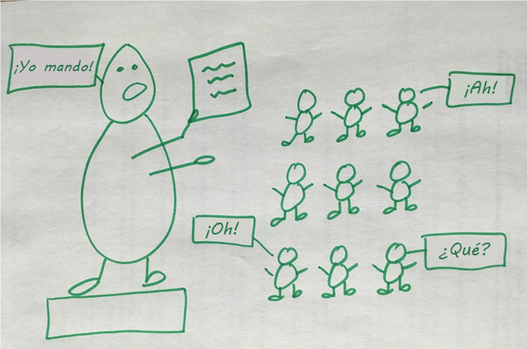
Cuatro modelos de liderazgo
Notes:
Ask, “What does this model tell or suggest to you? What kind of a leader is this? What might we call this leader? When would it be appropriate to use this leadership model? What are the advantages or disadvantages of this model?”
Explain that we could call this style “authoritarian” or “autocratic.”
Clarify the meaning of each type of leadership by referencing the handout on the four leadership styles.

Slide 8
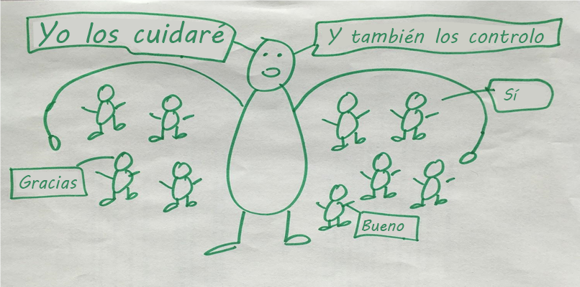
Cuatro modelos de liderazgo
Notes:
Ask, “What does this model tell or suggest to you? What kind of a leader is this? What might we call this leader? When would it be appropriate to use this leadership model? What are the advantages or disadvantages of this model?”
Explain that we could call this style “paternalistic” or “maternalistic.”
Clarify the meaning of each type of leadership by referencing the handout on the four leadership styles.

Slide 9
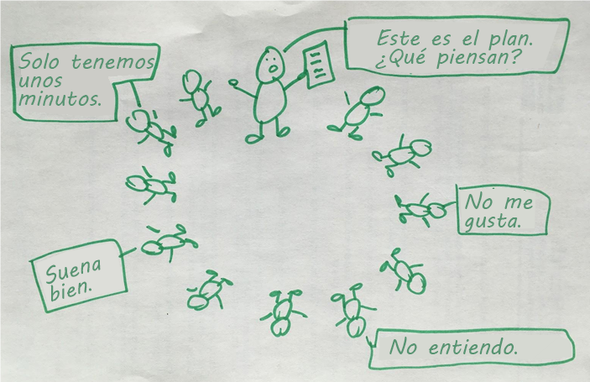
Cuatro modelos de liderazgo
Notes:
Ask, “What does this model tell or suggest to you? What kind of a leader is this? What might we call this leader? When would it be appropriate to use this leadership model? What are the advantages or disadvantages of this model?”
Explain that we could call this style “participatory.”
Clarify the meaning of each type of leadership by referencing the handout on the four leadership styles.

Slide 10
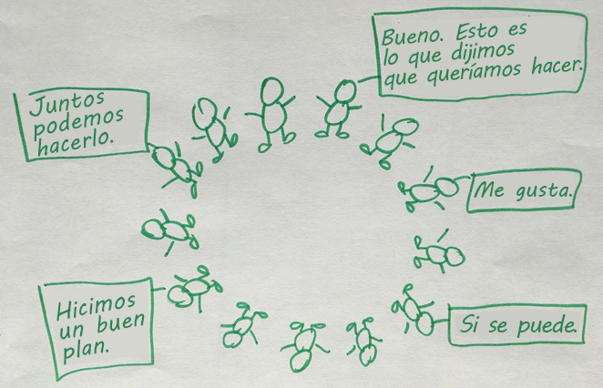
Cuatro modelos de liderazgo
Notes:
Ask, “What does this model tell or suggest to you? What kind of a leader is this? What might we call this leader? When would it be appropriate to use this leadership model? What are the advantages or disadvantages of this model?”
Explain that we could call this style “empowering.”
Clarify the meaning of each type of leadership by referencing the handout on the four leadership styles.
Reflection: Ask, “Which style or styles of leadership will be most effective in your role as a CHW in your own community?”
Reference the Expressions of Power handout. Share that the “power with,” “power to,” and “power within” models can be helpful ways for us to understanding an empowering approach to leadership.

Slide 11
Empoderamiento: una definición y reflexión
“El empoderamiento es el proceso mediante el que las personas adquieren un mayor control sobre las decisiones y acciones que afectan su salud”. – Organización Mundial de la Salud, 1986
“El poder sin amor es peligroso y abusivo, y el amor sin poder es sentimental y anémico. El mejor poder es el amor que implementa las demandas de justicia, y la mejor justicia es el poder que corrige todo lo que se opone al amor”. – Dr. Martin Luther King, Jr.
Notes:
As we mentioned in the last activity, taking an empowering approach to how we lead and work with others is a best practice for CHWs. We wanted to offer some additional information about what empowerment is and some of the related skills and qualities.
Read definition and Dr. King quote.
Ask, “What do you notice about these definitions/quotes? How do they connect with your work?”

Slide 12
Actividad: escenarios de empoderamiento
Lean los escenarios en grupo.
Analicen cómo sería un enfoque de empoderamiento para cada escenario.
Usen el folleto de habilidades y cualidades de empoderamiento como guía de referencia. Agreguen sus ideas sobre las habilidades y cualidades adicionales de un líder empoderante.
Prepárense para compartir de forma breve un ejemplo de un enfoque de empoderamiento a partir de su análisis.
Notes:
Distribute the Characteristics of Empowering Leadership handout and case scenarios and break participants into small groups.
Explain that participants will now have a chance to work in small groups to practice thinking through what an empowering approach to different scenarios would look like. Read through the scenarios in your group and talk through what an empowering leadership approach to the scenario could be. You can use the skills and qualities handout as a reference guide. We encourage you to add your own thoughts/ideas to the skills and qualities handout.
Allow for 20 minutes for work in small groups. Reconvene the large group for report backs.

